Slide 1
Introduction to Microsoft Azure DevOps
Azure Training

Slide 2

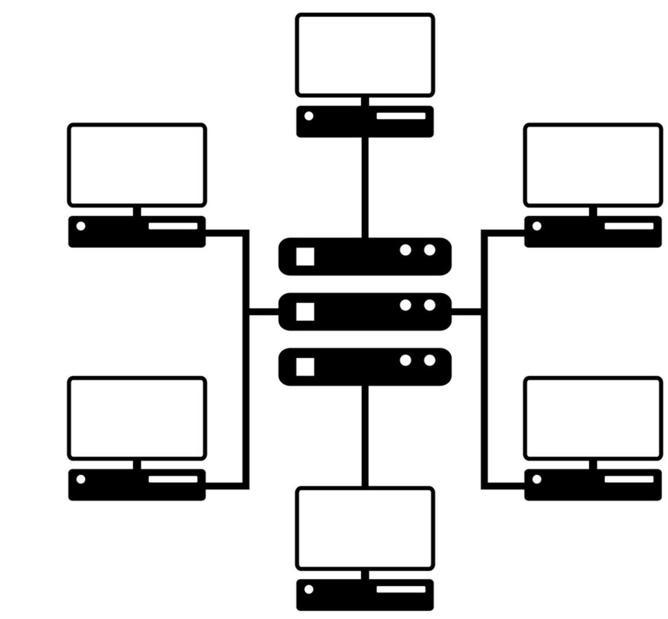
Intro to Infrastructure as a code
Problem:
Software development lifecycle is complex and require different elements to work together to be successful:
Documentation of the requirements
Keeping your source code secure and backed up
Testing results need to be accessible
Release process need to be under control
Etc.
Upload ARM Templates to Repo
Define Build Pipeline
Create Release Pipeline
Assign variables to pipeline
Self-contained: Access = copy of Repo and entire codebase and history

Slide 3
Solution:
Azure DevOps – platform that gathers solutions for all the problems listed of software development lifecycle

Slide 4
Agenda
Overview (Organisation + Project)
Boards
Repos
Pipelines

Slide 5
Overview
What is Azure DevOps
Portal that provides to developer services for:
support teams to plan work
collaborate on code development
build and deploy applications
It brings together developers and project managers and contributors together to complete software development.
Read more at: DevOps

Slide 6
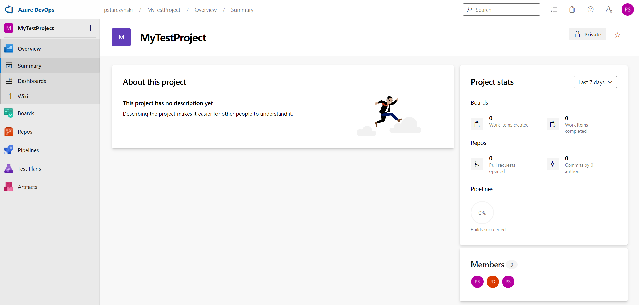
Overview

Slide 7


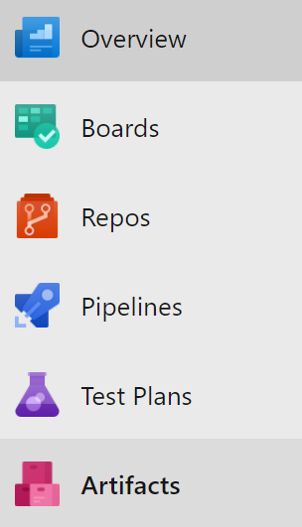
Overview
DevOps Structure
Access
DevOps Portal
Organisation 1
Project 1
Teams
Security
Board
Repositories
Pipelines
Test Plans
Project 2
Organisation N

Slide 8

Overview
How to access it?
Use any modern browser (chrome, edge etc.)
Organisation Level
https://dev.azure.com/{organisation}
Project Level
https://dev.azure.com/{organisation}/{project}
Hot Tip: Do not use spaces in organisation/project/repository as project link will look messy like this:
https://Dev.azure.com/my%20organisation/This%20is%20very%20complex%20project%20name

Slide 9
Overview
Why should I use it?
Provide great integration between services
Extensible and configurable to needs by set of add-ins (marketplace)
Cost effective (free to very small organisations up to 5 people without MSDN licenses)
Can be hosted both OnPrem/Cloud
Integrates with Azure Active Directory
Accessible (browser based, one account –access to all services)

Slide 10
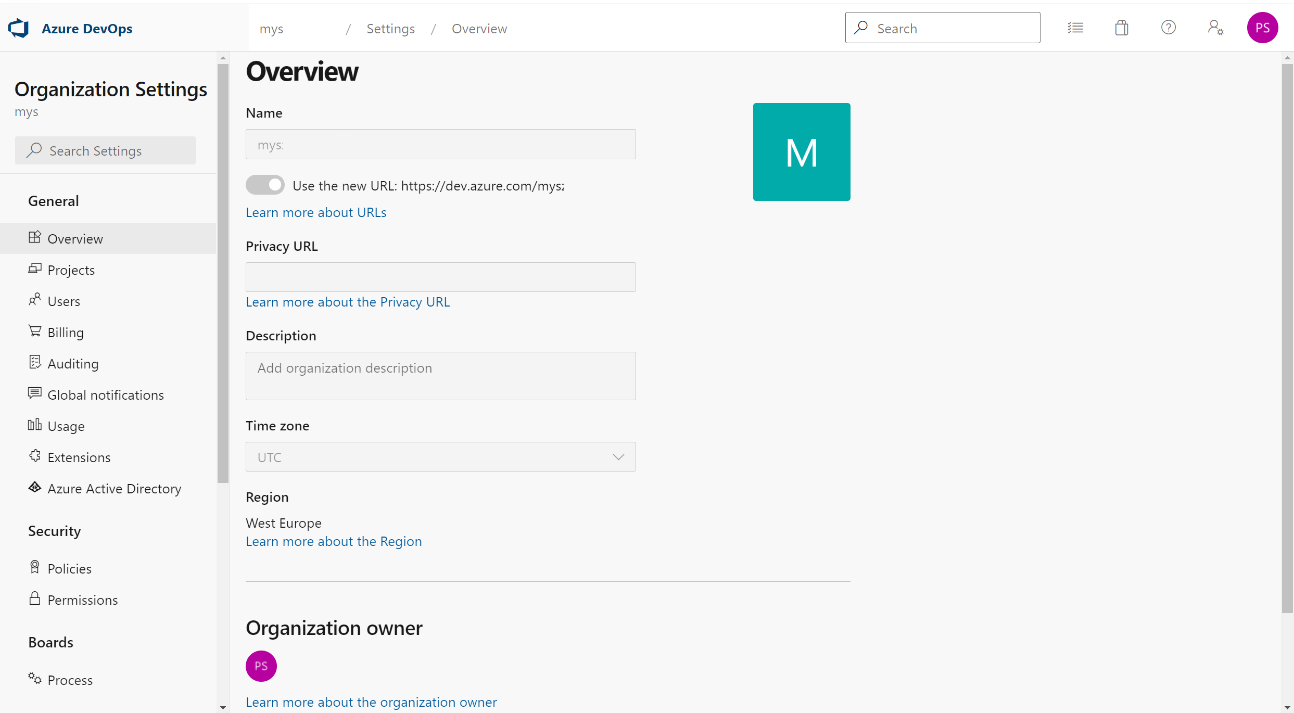
Overview
DevOps Organisation - Settings
Important Organisation Settings
Unique URL of organisation
Location
Projects
Users
Extensions
AAD - Link DevOps Users with AAD
1
3
4
5
6
2
Hot Tip:
Use location closest to your physical location
Users need to be added in organisation before become visible on the project
Notes:
Location – default location is based on the closest azure regions (can be modified by organisation owner within allowed regions)
Projects – project management
Users – adding/removing users and configuration what license it uses

Slide 11
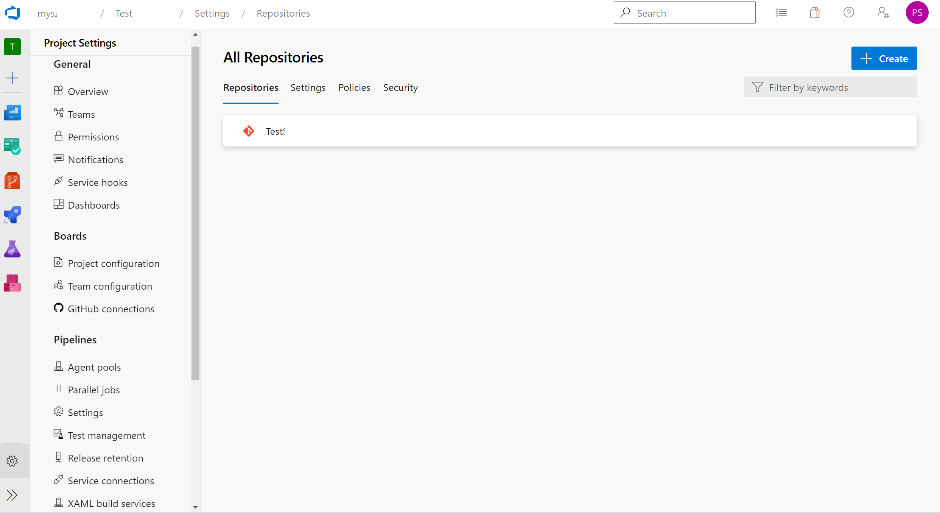
Overview
Project -Settings
1
2
3
4
5
Notes:
Team User configuration
Project Configuration – Configuring sprints
Team configuration – Backlog level, work days
Agent Pools – configure agents for Pipelines
Service Connection – connection to external services e.g., Azure
Repositories (not visible on the screen)

Slide 12
Agenda
Overview (Organisation + Project)
Boards
Repos
Pipelines

Slide 13
Intro to Infrastructure as a code
Problem:
Documentation of the requirements is a complex process. Requirements need to be documented this way so there is not room for misinterpretation of the requirement by the development team. Requirements need to be documented in single place and be clear for every team member of the development team. Team need to be able to track what requirement was already delivered
Solution:
Boards – Azure DevOps platform feature
Upload ARM Templates to Repo
Define Build Pipeline
Create Release Pipeline
Assign variables to pipeline
Self-contained: Access = copy of Repo and entire codebase and history

Slide 14
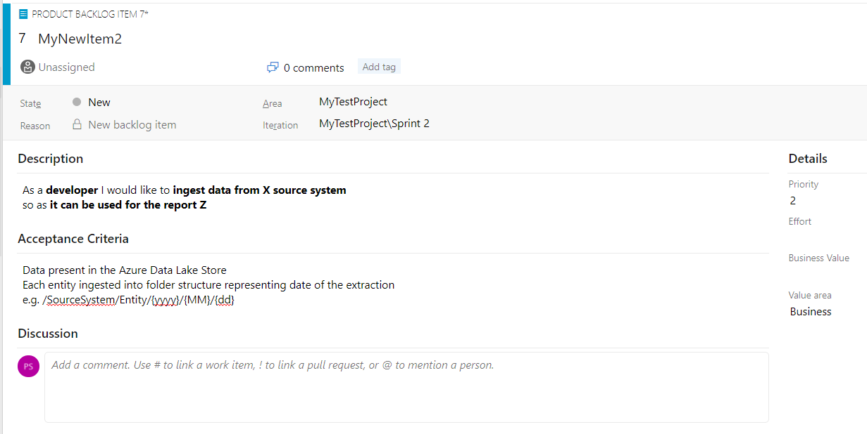
Boards – Why it is needed?
Boards
Managing requirements - Used to manage requirements, (Description, Acceptance criteria, conversations between stakeholders)
Notes:
PO-Product Owner
PM-Project Manager
PS- Project Sponsor

Slide 15
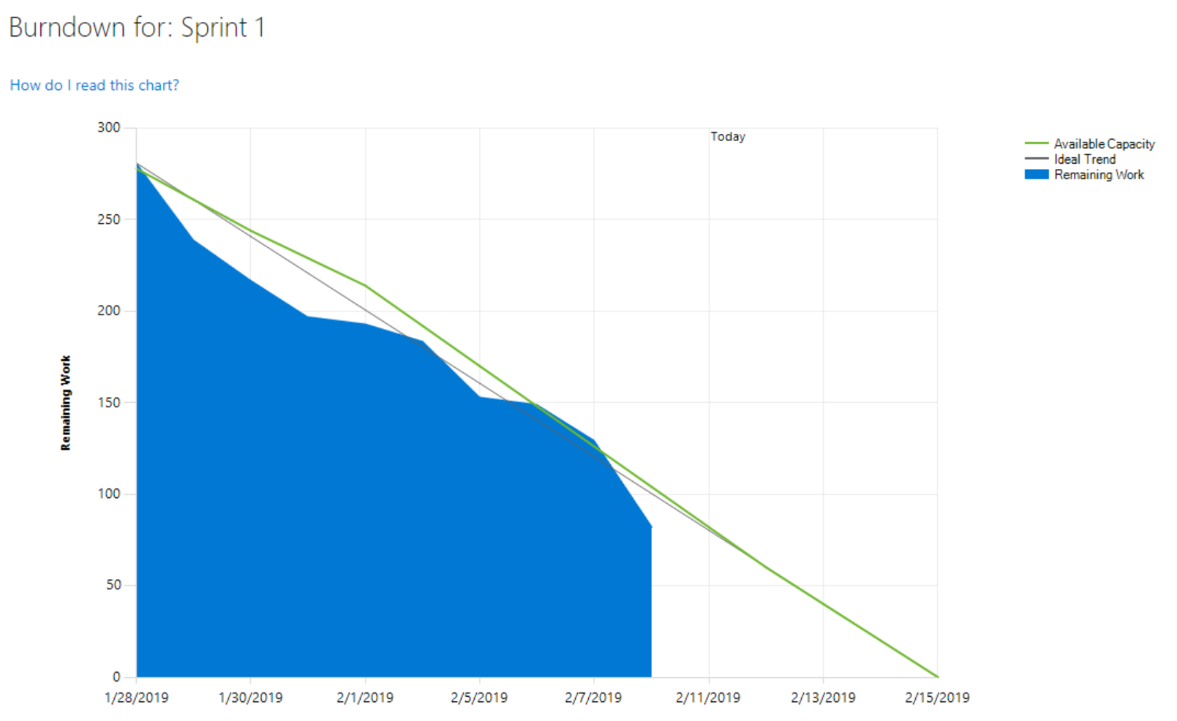
Boards – Why it is needed?
Boards
Increase Transparency and visibility - Provide insight for the team and management of the project (PM, PO, PS) about velocity of the team and work left to finish in the sprint
Notes:
PO-Product Owner
PM-Project Manager
PS- Project Sponsor

Slide 16
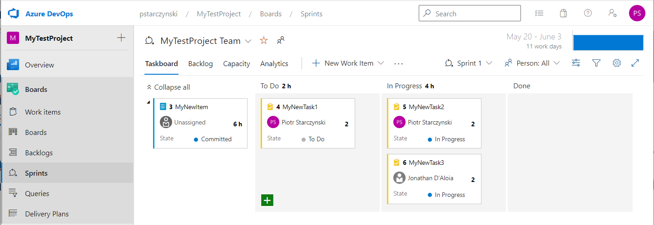
Boards – Why it is needed?
Boards
Ease Collaboration - ease the collaboration in the team through interactive boards. Allows team members to take responsibility for delivering the work items, features
Notes:
PO-Product Owner
PM-Project Manager
PS- Project Sponsor

Slide 17
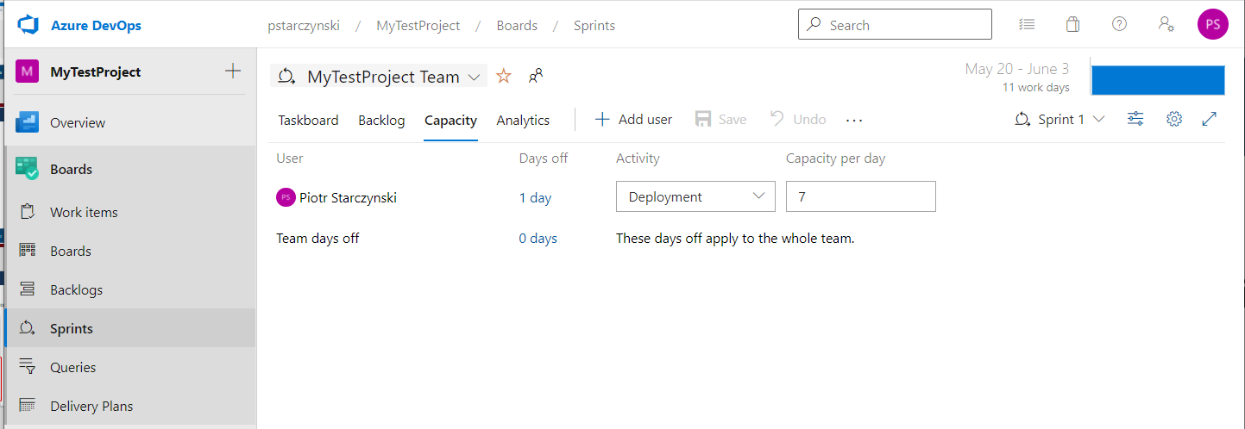
Boards – Why it is needed?
Boards
Ease Planning – Configuring team capacity against sprint effort to deliver
1
3
2
4
5
Notes:
PO-Product Owner
PM-Project Manager
PS- Project Sponsor

Slide 18
Boards– Why it is needed?
Boards
Configurable to the workstyle of the team – Boards contain multiple work approach templates (Scrum, Agile, Basic, CMMI), each template can be additionally configured with DevOps configuration or via Market Place add-ins
Bulk changes enabled – with some add-ins bulk changes can be made to create the board quicker or migrate it to other projects (some changes can be done in the UI other it is better to do it via add-ins
Finding specific work items – Can by id or name
Code Change tracking - Linking code changes (commits) with work item (business need)
Hot Tip: Install Excel Add in that speed up bulk operations

Slide 19
Boards– Work Items
How boards track requirements?
Work item – do not confuse with “Backlog Item/Item” (work item type)
Work Items – what it is?
Work item – it is a family of object that is used to track the requirements/ bugs/defects
work item is essentially a container that can store a requirement and metadata (textual or numeric) and can have child/parent work items associated with them.
Usually, the make a tree like structure but not necessarily have to have common root.

Slide 20
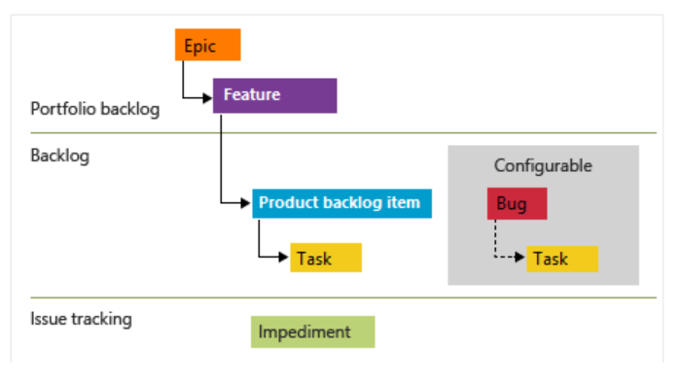
Boards
Epic – most hight level work item, used to group common features together
Feature – hight level work item that groups together all items that are required to deliver the feature
Product Backlog Item (Story)
document a requirements for a single story
Group together development tasks that need to be carried out to deliver the story
Work Items Types (WIT) on Scrum Template Example
Notes:
Story – captures single requirement of the feature As a “X” I would like software to do “Y” so that I can do “Z”

Slide 21
Boards
Task – most low-level work item that represent a single unit of work that need to be carried to deliver a work item
Bug Work Item
Same level as a Story
Captures details of the bugs, all the acceptance criteria for the resolving of the bug
Groups together Tasks that are required to fix the bug
Work Items Types (WIT) on Scrum Template Example

Slide 22
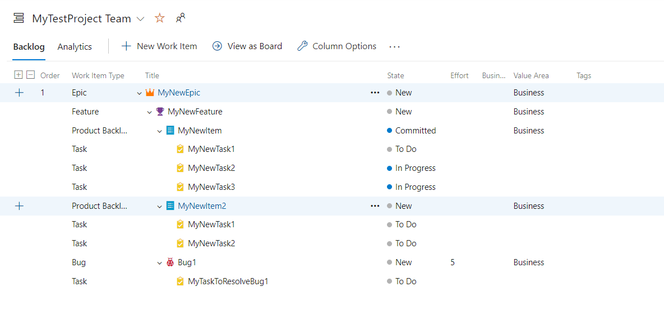
Boards
Work Item Tree example
Notes:
Unique identifier
Title
State
Time Criticality (coming from the business)
Business Value
Person responsible

Slide 23
Boards
Backlog Item

Slide 24
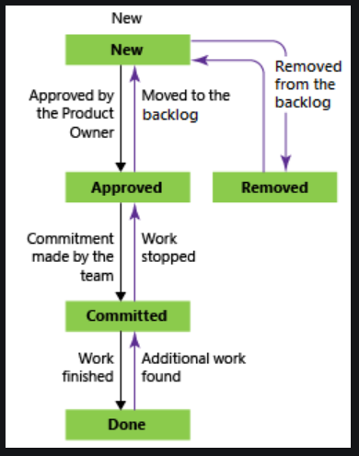
Boards
Flow of state – Item
Newly created in backlog
Ready for the sprint
(could be set on backlog refinement session)
Removed from the backlog (track history-may come back)
Committed to deliver in current sprint
All the task finished

Slide 25
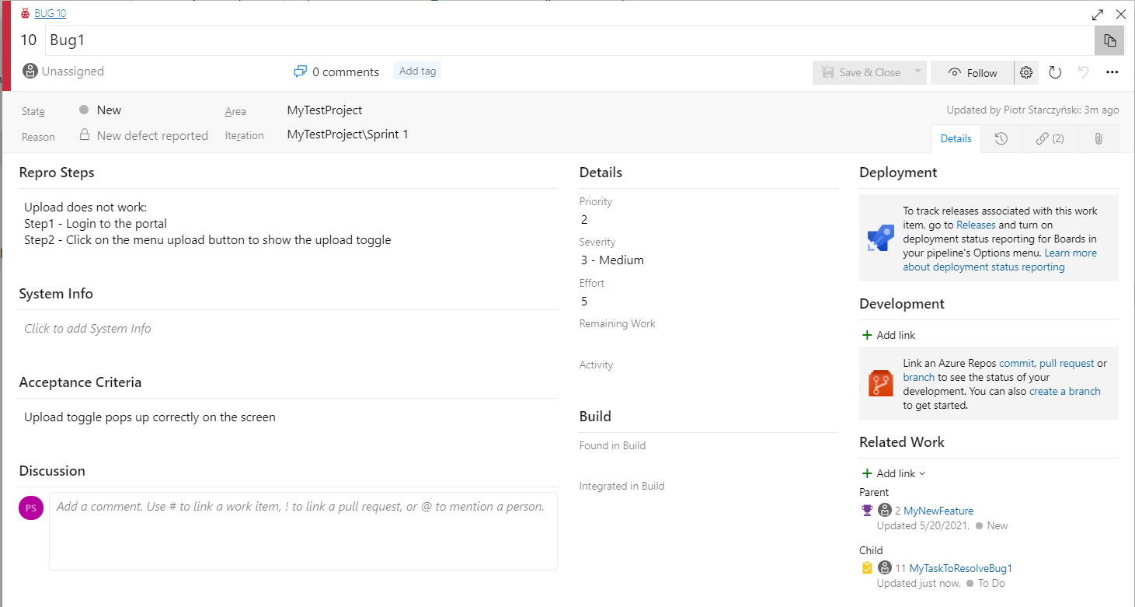
Boards
Bug

Slide 26
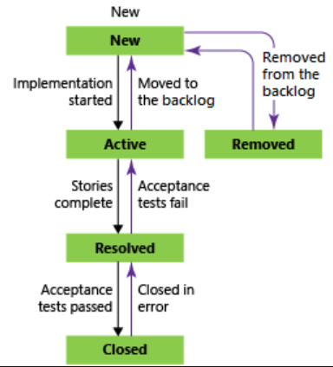
Boards
Flow of state – Bug
Newly created in backlog
Removed from the backlog (track history-may come back)
In progress (owner assigned)
All tasks completed
Tested

Slide 27
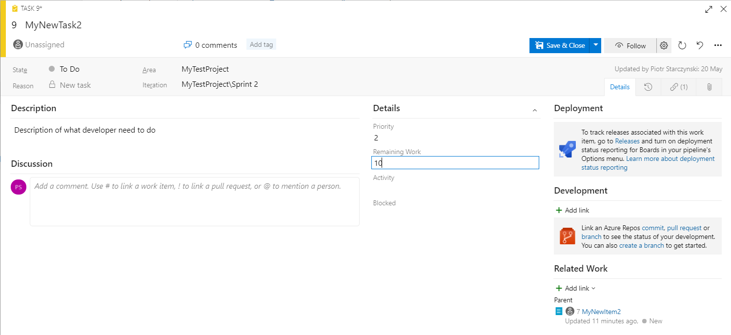
Boards
Task

Slide 28
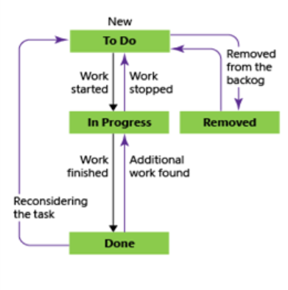
Boards
Flow of state – Task
Newly created in backlog
Removed from the backlog (track history-may come back)
Dev team working on it (person assigned)
Dev team finished it

Slide 29
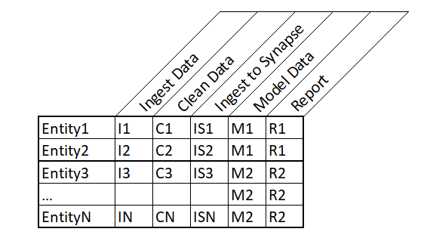
Boards
Splitting work in to work items
Horizontal Cut vs Vertical Cut
Epic – Reports for X
Features – Report 1 (R1)
item - Ingest Data (I1)
Task – Configure Metadata
item – Clean Data (C1)
Epic – Report for X
Feature – Ingest Data
item - Ingest Source 1 (I1)
Task – Configure Metadata
item – Ingest Source 2 (I2)
Feature – Clean Data
item – Clean Source 1
item – Clean Source 2

Slide 30
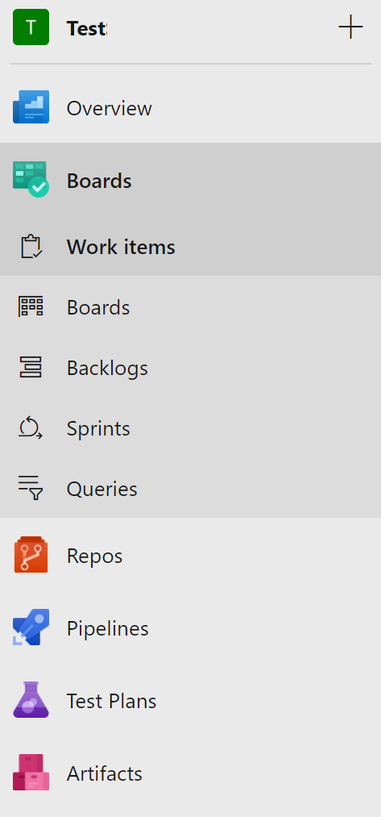
Boards – How to access
Boards
Boards are accessible on the side panel of DevOps platform. Only person assigned to the project and project team can view and change the boards (Excl. Admins).
1 - Full list of all work items created in the Boards
2 - Board view of the Backlog – provide hight level view of work items in form of “board view”
3 - Prioritized list of work items, useful when creating plan for the sprint
4 – View of backlog items with perspective of Sprint
Provide better view for showing the progress of the sprint
5- Query view for the backlog items for advanced filtering
1
2
3
4
5
Notes:
1 - Full list of all work items (epics/features/items/Tasks/Bugs etc.) that is not prioritized
2 - Board view of the Backlog – provide hight level view of work items in form of board view e.g., which work items are committed by the team, are done by the team (not in relation to sprint)
3 - Prioritized list of work items - useful when creating plan for the sprint and assigning work to the sprint or reassigning back to the backlog
4 – Sprint View - used during the sprint by the development team for progress tracking, provides pure visibility about what was/is/will be the scope of the sprints (past, current and future sprints).
5 – Queries – Querying interface for selecting items based on the query (useful for bulk updates, exporting/importing items to the backlog.)

Slide 31
Agenda
Overview
Boards
Repos
Pipelines

Slide 32
Intro to Infrastructure as a code
Problem:
Not using source control may lead to poor results in software development lifecycle. Solution Code must always be source controlled and source control should follow the rules below:
Versioned – code changes need to be versioned we should be able to restore previous version at any time of the development
Changes to the solution code need to be audited who made a change and for what purpose
Accessible only by authorized users (for viewing and modification)
Stored in the place that would allow easy collaboration within team or between different teams
Provide isolation - Allow working on features without affecting other features
Upload ARM Templates to Repo
Define Build Pipeline
Create Release Pipeline
Assign variables to pipeline
Self-contained: Access = copy of Repo and entire codebase and history

Slide 33
Intro to Infrastructure as a code
Solution:
Repos – Azure DevOps platform feature
Upload ARM Templates to Repo
Define Build Pipeline
Create Release Pipeline
Assign variables to pipeline
Self-contained: Access = copy of Repo and entire codebase and history

Slide 34


Repos - Overview
What is Azure Repos?
Service that provide centralised code repository solution
- TFVC – Team Foundation Version Control
- GIT - default and recommended version control
Who can make changes on Repos?
User that has min Visual Studio Subscription/Basic access assigned in DevOps Organisation – people without this will not see Repos panel
User that belongs to the team
Notes:
More information can be found here:
https://docs.microsoft.com/en-us/azure/devops/repos/tfvc/comparison-git-tfvc?view=azure-devops
TFVC – centralised, not distributed
GIT – centralised, distributed (there is centralised repo, but each user has also its own local version of repository)

Slide 35
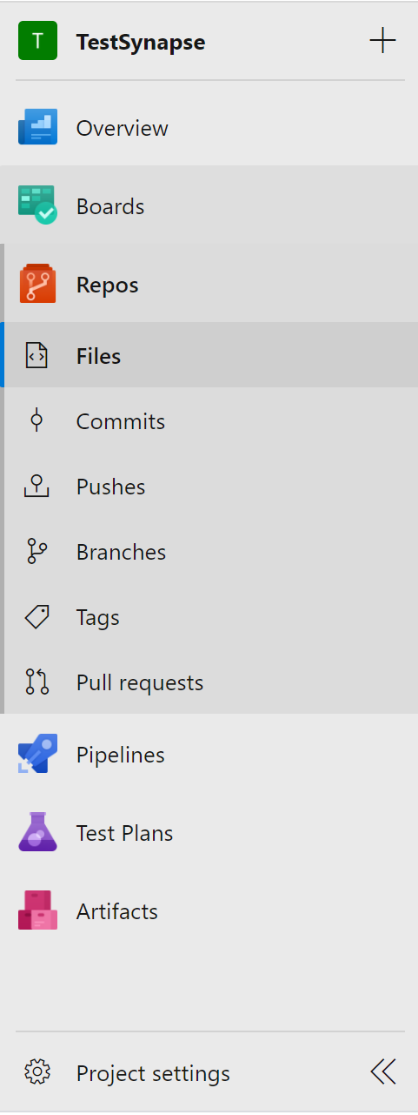
Repos - Overview
Files – Repository File Explorer
Commits – Changes explorer - list of code commits to the repository including the highlight of the changes for text-based files
Pushes – List of all push actions made to the repository
Branches – Branches management/explorer
Tags – list of all tags in the repository
Pull Requests –pull requests management/explorer
1
2
3
4
5
6
Notes:
This is where all the code is uploaded, represents current state of the codebase on the selected branch (main by default)
Commits – list of commits
Tags – named references to commit (tags particular state of the repository so it can be referenced by name)

Slide 36
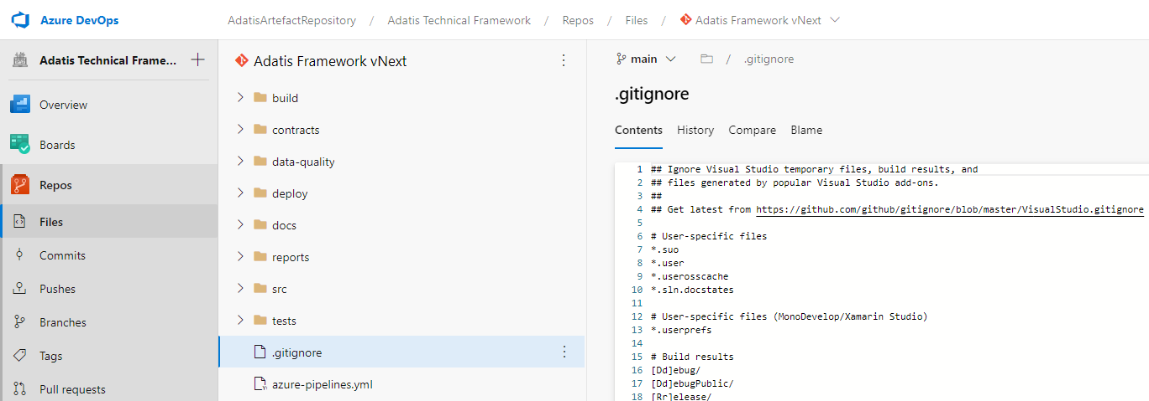
Repos - Overview
Files– Online Explorer
Notes:
This is where all the code is uploaded, represents current state of the codebase on the selected branch (main by default)
Commits – list of commits
Tags – named references to commit (tags particular state of the repository so it can be referenced by name)

Slide 37
Repos – Branches
Branches– Storing multiple version of the same code
C1
main/master branch
Feature branch 1
C2
C4
Feature branch 2
C5
Notes:
Shows the view of all Pull requests (Active/Completed/Abandoned)
Can be used to crate new Pull request (but usually this is done via branch tab)

Slide 38
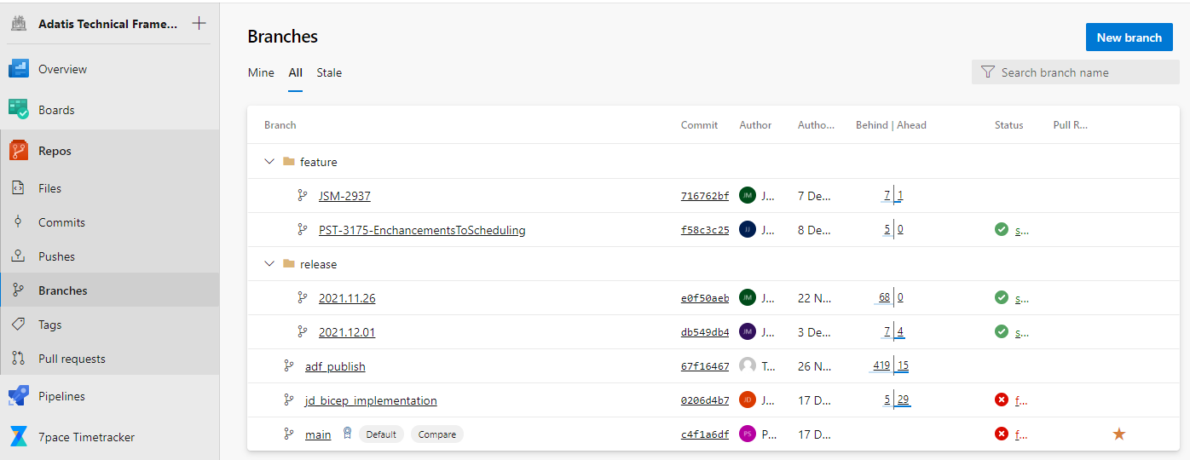
Repos – Branches
Branches– Storing multiple version of the same code
Notes:
Shows the view of all Pull requests (Active/Completed/Abandoned)
Can be used to crate new Pull request (but usually this is done via branch tab)

Slide 39
Repos – Pull Requests
Pull Request – Pull Request View
C1
C3
C5
main/master branch
PR-Pull Request
Feature branch
C2
C4
Notes:
Shows the view of all Pull requests (Active/Completed/Abandoned)
Can be used to crate new Pull request (but usually this is done via branch tab)

Slide 40
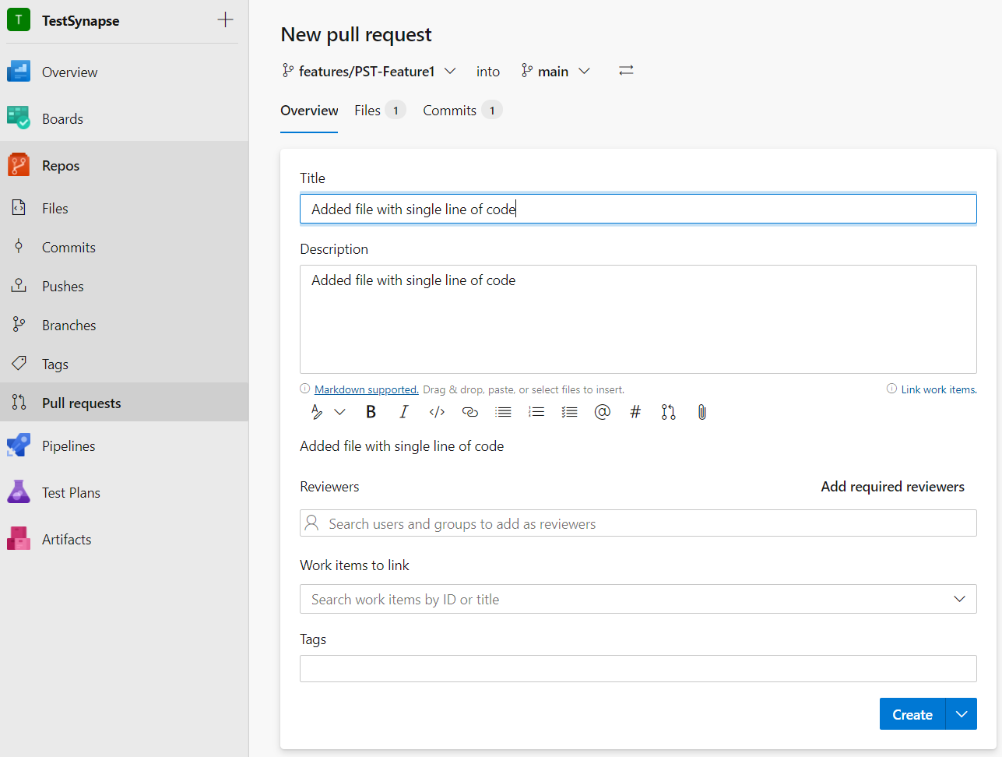
Repos – Pull Requests
Pull Request – Creating Pull Request
2
1
6
3
4
5
Notes:
Define Source branch of the pull request (pull from)
Define target branch for the pull request (pull to)
Define title for the pull request (usually some meaningful title that informs about what feature/item has been completed
Request reviewers (can be added automatically with branch Policies)
Link work item from the board into Pull request
Files and Commits for a review that are part of the pull request (only changes associated with work item should be transferred into the main branch)

Slide 41
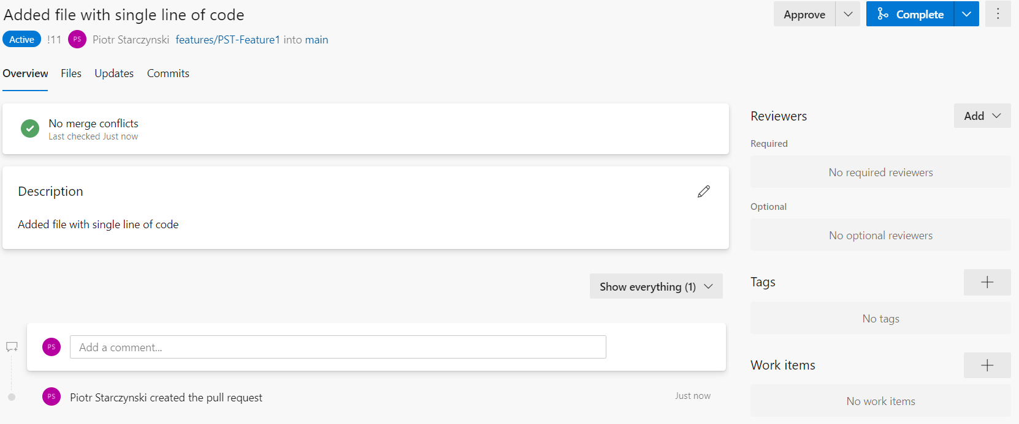
Repos – Pull Requests
Pull Request – Approving Pull Request
1
2
3
4
5
6
Notes:
Button for approvers after the review the code (4)
Complete/Autocomplete PR if all conditions are met
Additional actions like (cherry pick changes etc.)
Provides list of changes for the code review
Provide ability to add additional information like:
Tags to a pull request so the final commit has associated tag
Reviewers
Work items
When Pull Request (PR) is Active then new commits can be added to the branch if required to fix and the PR can be completed)

Slide 42
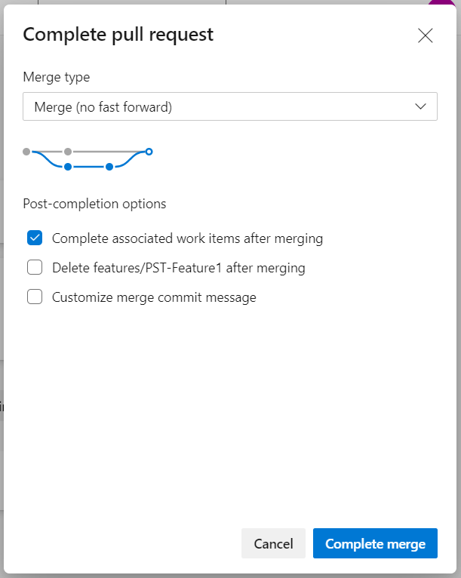
Repos – Pull Requests
Pull Request – Completing Pull Request
1
Available Merge Types:
Merge – no fast forward
Squash commit
Rebase and Fast Forward
Semi linear
2
3
4
Notes:
Chose merge type – available (MERGE - No fast forward)
Chose if work items should be completed
Chose if to delete the branch (source branch we pull from)
Complete the pull request

Slide 43


Repos – Pull Requests
Pull Request – Merge Types - Merge
Branches are merged via a new single commit on the target branch, history of commits on the feature branch are preserved
Notes:
Chose merge type – available (MERGE - No fast forward)
Chose if work items should be completed
Chose if to delete the branch (source branch we pull from)
Complete the pull request

Slide 44

Repos – Pull Requests
Pull Request – Merge Types - Squash
Squash all commits into a single commit and re-apply it on the target branch as a new commit
this type of merge does not preserve the history of commits on the feature branch nor on the target branch
Notes:
Chose merge type – available (MERGE - No fast forward)
Chose if work items should be completed
Chose if to delete the branch (source branch we pull from)
Complete the pull request

Slide 45

Repos – Pull Requests
Pull Request – Merge Types – Rebase and FF
Commits are re-applied on the target branch as a new commits as they would be created on the target branch
History of the original commits on the feature branch is not preserved
Notes:
Chose merge type – available (MERGE - No fast forward)
Chose if work items should be completed
Chose if to delete the branch (source branch we pull from)
Complete the pull request

Slide 46

Repos – Pull Requests
Pull Request – Merge Types – Semi linear
Feature branch change a root to be the head of the target branch feature branch commits are preserved and final commit is made for the merge on the target branch
Notes:
Chose merge type – available (MERGE - No fast forward)
Chose if work items should be completed
Chose if to delete the branch (source branch we pull from)
Complete the pull request

Slide 47
Agenda
Overview
Boards
Repos
Pipelines

Slide 48
Intro to Infrastructure as a code
Problem:
Deployment process can be very complex – created with multiple stages that need to be executed in certain order. Without good instruction deployment of the new environment is difficult.
Deployment usually is containing repetitive manual process, that leave lots of room for human error. Deployment are not often due to amount of time required for the deployment.
Solution:
Azure Pipelines (DevOps Pipelines) – self documenting deployment process
Upload ARM Templates to Repo
Define Build Pipeline
Create Release Pipeline
Assign variables to pipeline
Self-contained: Access = copy of Repo and entire codebase and history

Slide 49
Pipelines
What is Azure Pipelines?
Service that enables definition and configuration of the deployment process.
Who can configure Pipelines?
User that has min Visual Studio Subscription/Basic access assigned in DevOps Organisation – people without this will not see Pipelines panel
User that belongs to:
Build and Release Administrators
Admin/Contributor of the project

Slide 50
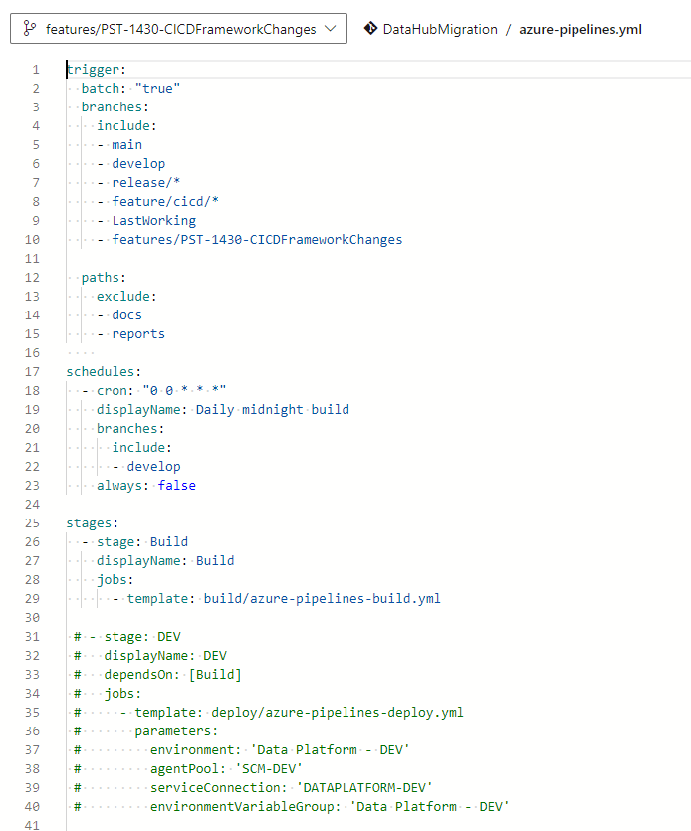
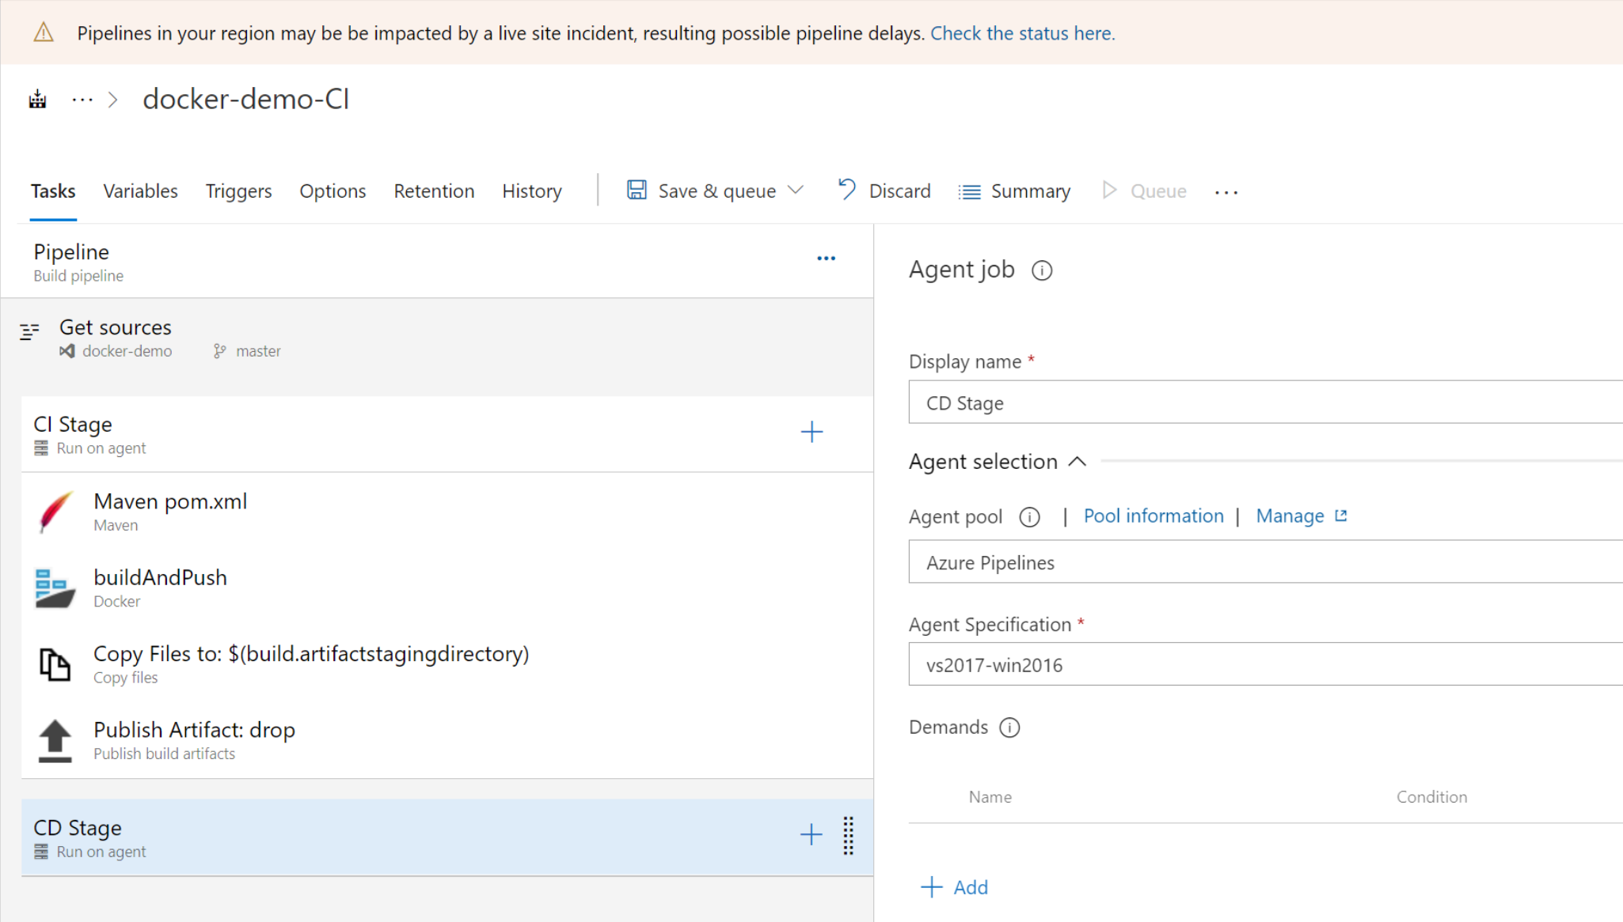
Pipelines
Type of pipelines?
YAML Pipelines
Classic Pipelines

Slide 51
Pipelines
Multistage YAML Pipelines
Build stored together with Release
Less mature (some features still under development)
Created via YAML stored with YAML on the repository with the rest of the code
Can be easy exported/Imported
Can be parameterized (different ways of parameterization)
Easier templating for reuse
Less functionality and configuration – e.g. manual stage not available

Slide 52
Pipelines
Classic Pipelines
Build defined separately from Release
More mature but will be deprecated at some point
Created via UI
Stored as JSON on the backend
Can be exported/Imported but require changes after import to work correctly
Can be parameterized

Slide 53
Pipelines
Azure Pipelines - Pipelines
Demo
-create the pipeline YAML
Notes:
Open Pipeline Tab – this is where you would create new/import existing pipelines
Recent pipelines executions log
Create new Pipeline (open
Import Pipeline – import existing pipeline

Slide 54
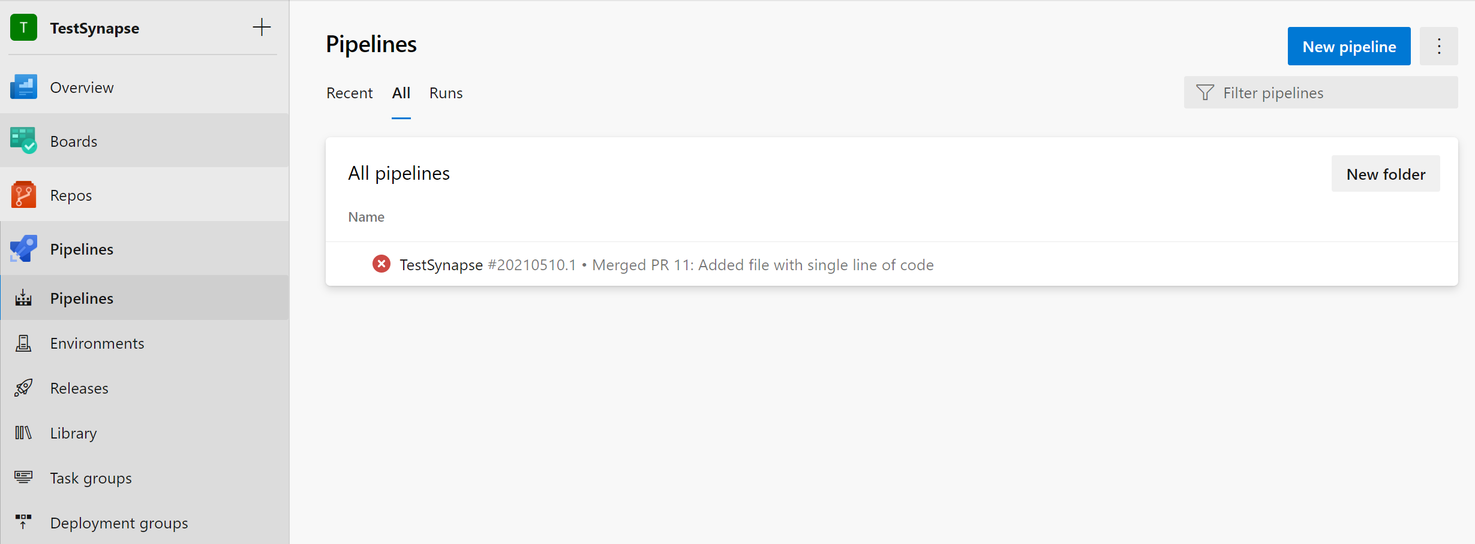
Pipelines
Azure Pipelines - Pipelines
4
3
2
1
Notes:
Open Pipeline Tab – this is where you would create new/import existing pipelines
Recent pipelines executions log
Create new Pipeline (open
Import Pipeline – import existing pipeline

Slide 55
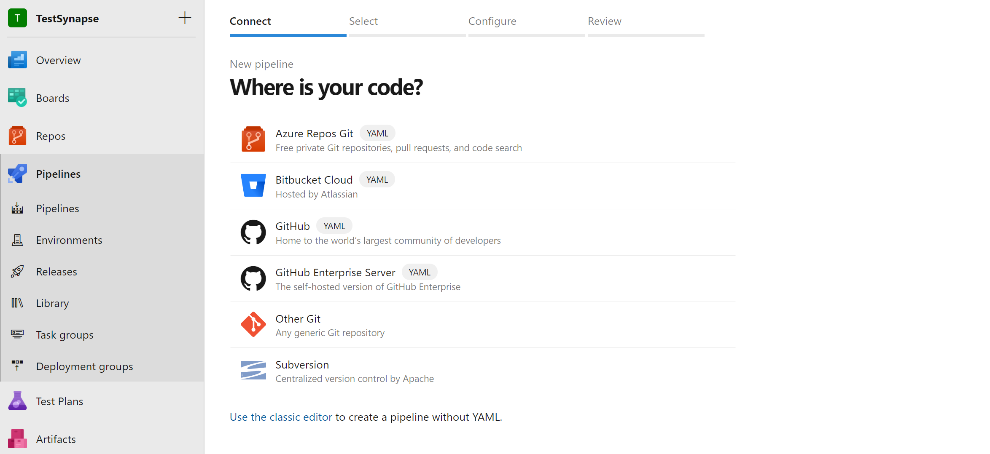
Pipelines
Azure Pipelines – Create pipeline (Page 1)
1
Notes:
3* – New Pipeline button - from previous page
Steps to create new pipeline:
Chose the GIT repository (if you use DevOps Git)

Slide 56
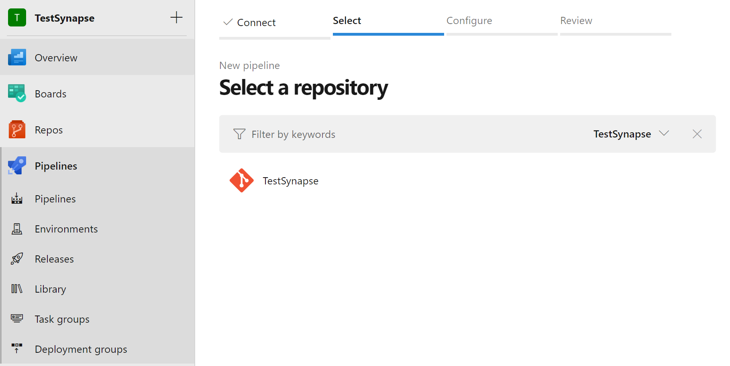
Azure Pipelines
Azure Pipelines – Create pipeline –Select Repo (Page 2)
1
Notes:
Steps to create new pipeline:
Chose the GIT repository (if you use DevOps Git)
Click this if you want to use classic pipelines (UI designer and pipelines stored in JSON) – not recommented

Slide 57
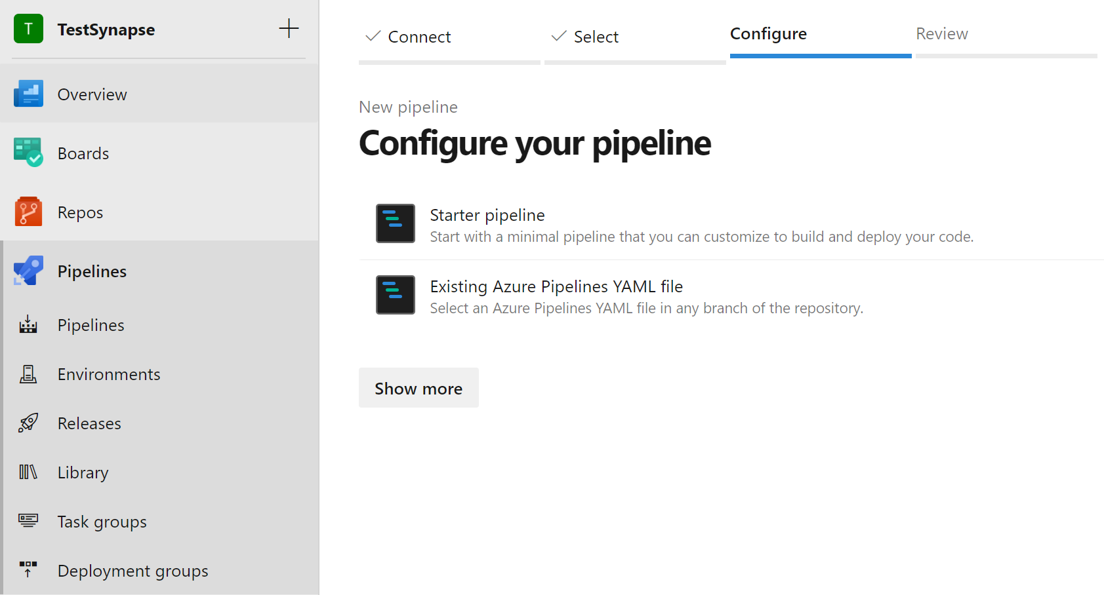
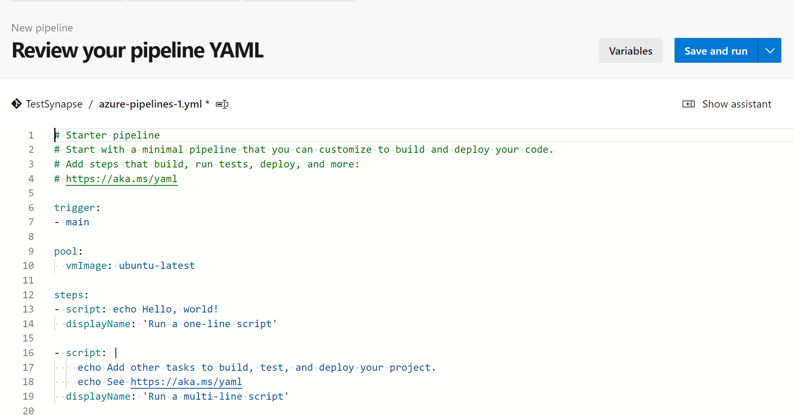
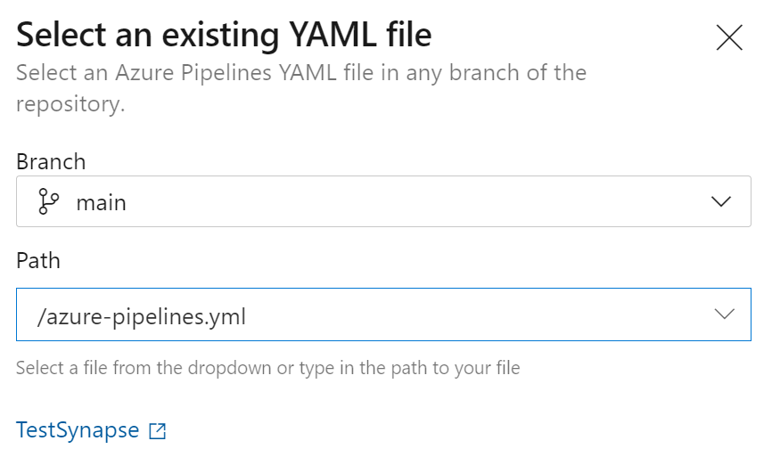
Azure Pipelines
Azure Pipelines – Create pipeline –Configure (Page 3)
1
2
Notes:
Steps to create new pipeline (chose 1 OR 2):
Create new – Create new pipeline based on the starter pipeline (will be saved in the repository)
Import - Chose existing YAML pipeline (need to reside in the repository)

Slide 58
Azure Pipelines
Azure Pipelines – Create pipeline –Review (Page 4)
2
3
1
Notes:
Review steps before pipeline is visible in the pipeline panel:
Configure path and file name of the pipeline
Variables – allows to create pipeline specific variables (ignore this at this stage), variables will be configured by linking YAML definition with Variable Groups in YAML Language
Save and run/Save pipeline (chose place on repository – could be in subfolders or on the root folder

Slide 59
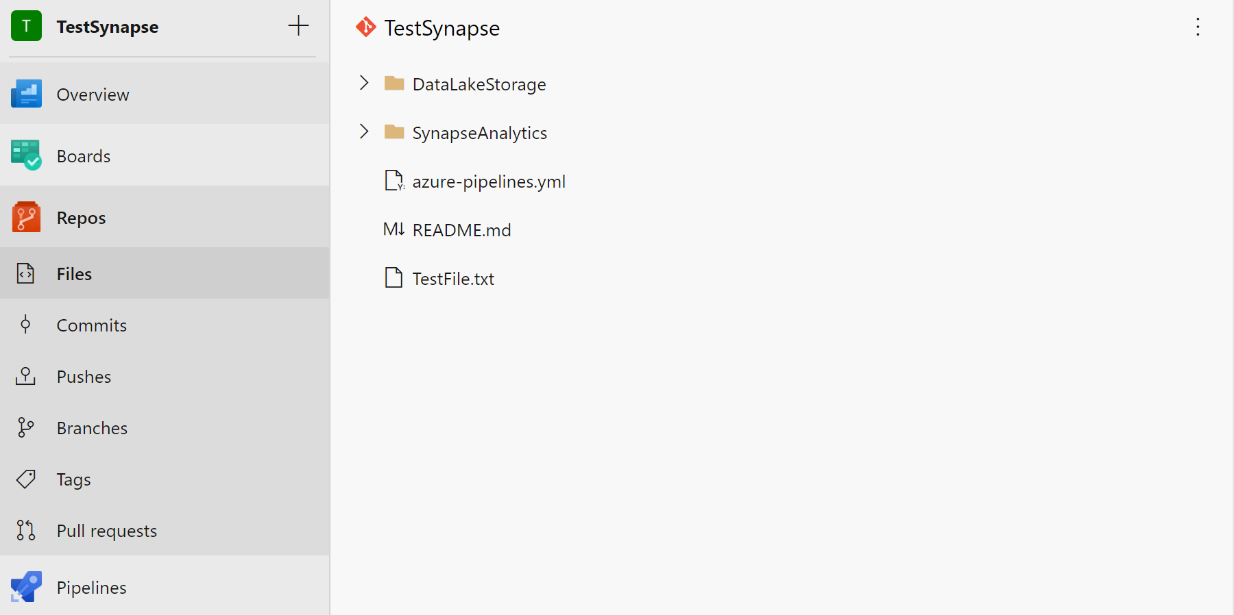
Azure Pipelines
Azure Pipelines – Where are they stored (default)?
Notes:
YAML pipelines are stored in source control alongside code
Can be stored inside a folder or be on the main level
There can be multiple YAML files (including the templates etc)
YAML pipeline is not visible unless imported to pipelines (done only once)

Slide 60
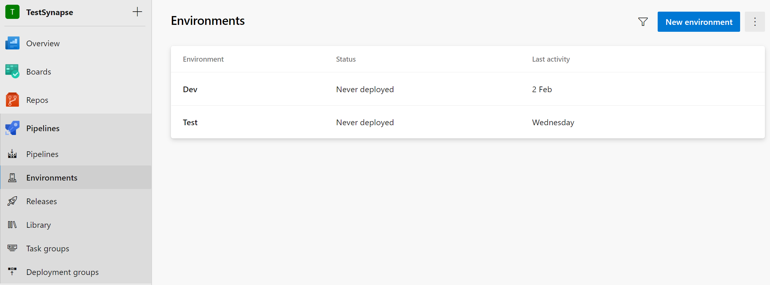
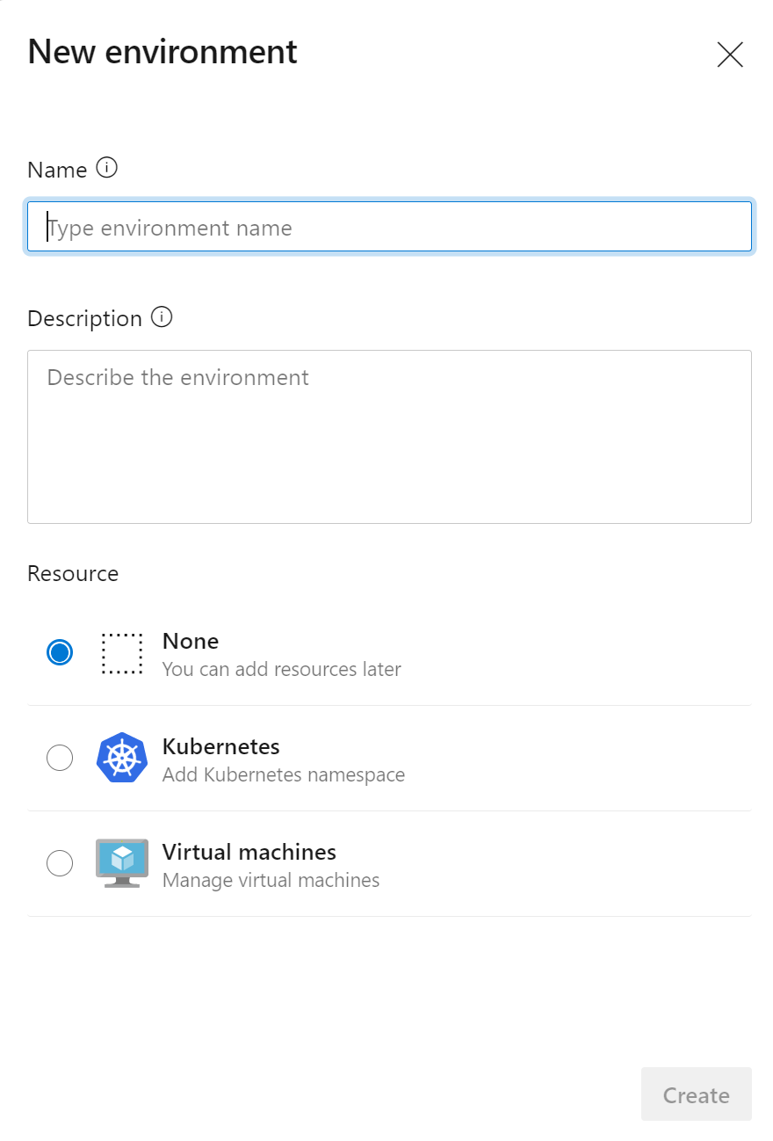
Azure Pipelines
Azure Pipelines-Environments
2
5
3
1
4
Notes:
1. Open Environments Panel – Define Environment that YAML pipeline can attach to (for Approvals and centralised place of the deployments )

Slide 61
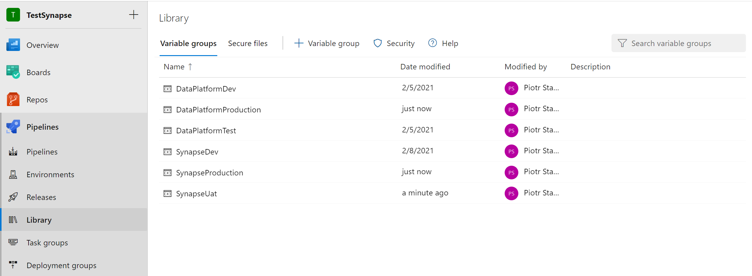
Azure Pipelines
Azure Pipelines –Variables Groups
Notes:
Variable Groups – it’s a set of Variables grouped together (same as variables but the are defined outside of the pipeline and then linked to the pipeline)
Use Variable groups per environment

Slide 62
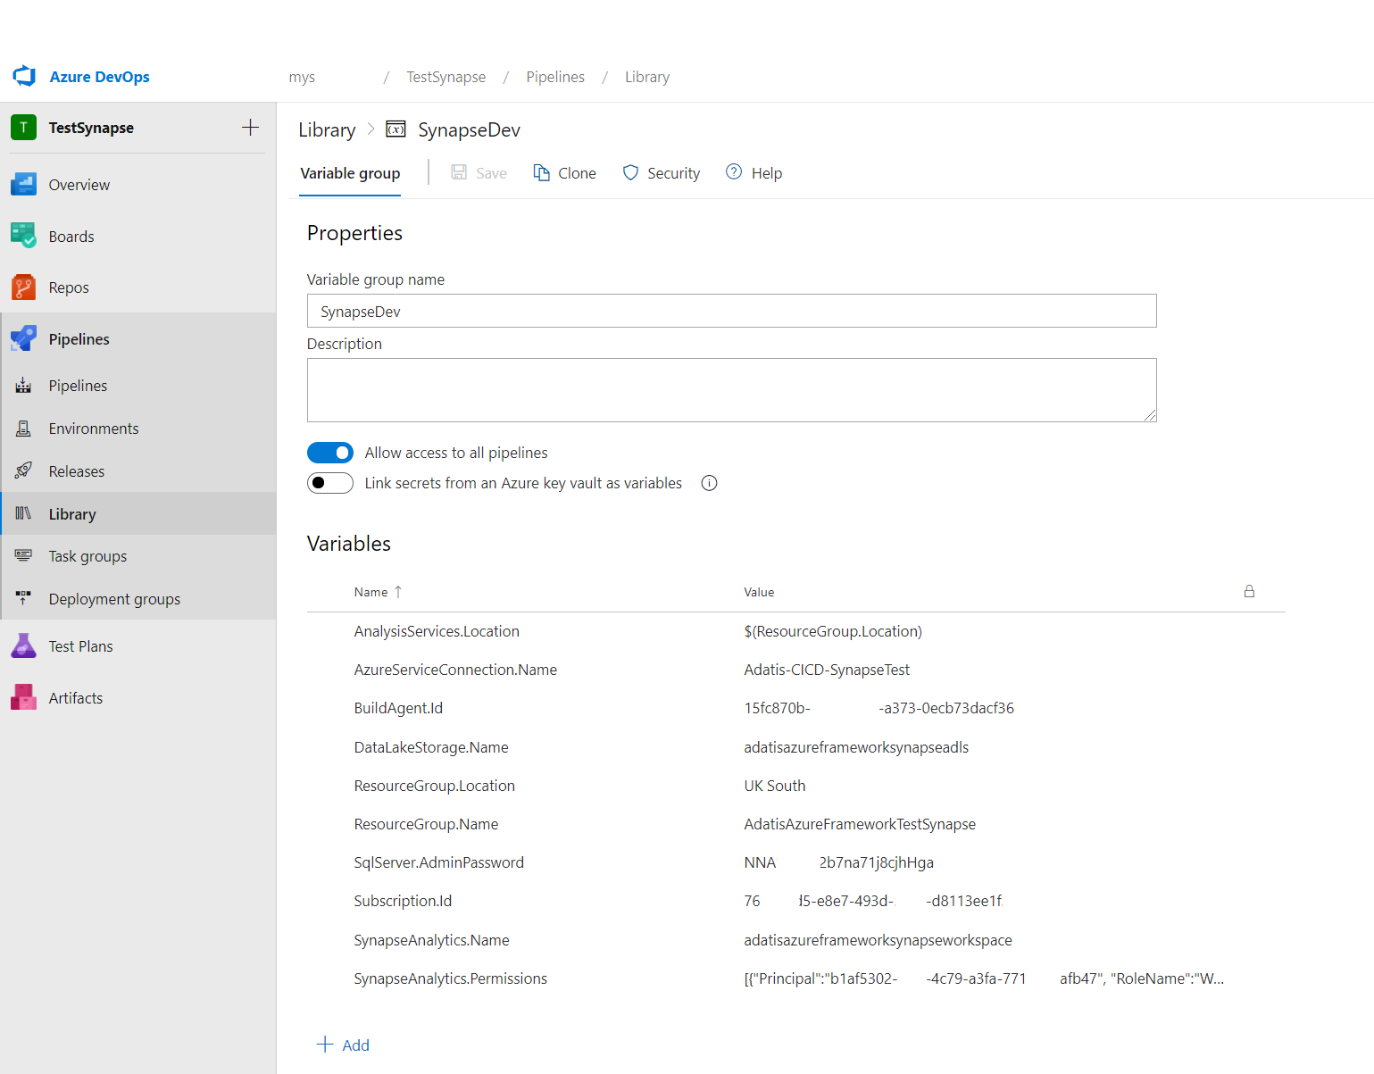

Azure Pipelines
Azure Pipelines –Variables Groups
1
Using variable in pipeline:
$(DataLakeStorage.Name) – gets replaced during the execution
2
3
4
5
How to hide sensitive information
6
Notes:
Key Value Paris used to store configuration (can store objects in json format)
Save Button – save variables after changes/Clone –clone whole variable groups under different name with the current variables and values (Values can be updated to another environment)
Name of the variable group – need to be descriptive enough so when we link it with the pipeline it is obvious what environment we are targeting
Sett access for pipelines to use this variable group
This configuration will change so all the values are stored in the KeyVault
Key Vaule pair that stores configuration
Name – Key (to retrieve this we will use $(DataLakeStorage.Name)
Value – Value of the configuration
sensitive information can be locked so they are not read only

Slide 63
Azure Pipelines
Azure Pipelines –Variables Groups (linking to pipeline)
Build
Release
Pipeline
Dev Stage
Test Stage
Prod Stage
Azure
Dev
Test
Prod
Notes:
Variable Groups – it’s a set of Variables grouped together (same as variables but the are defined outside of the pipeline and then linked to the pipeline)
Use Variable groups per environment
There could be one to many relationship (many of variable groups can be linked with the same pipeline)
Using variables in build stage is not that common (as this stage should be agnostic of environments)
Variables groups are mostly used

Slide 64
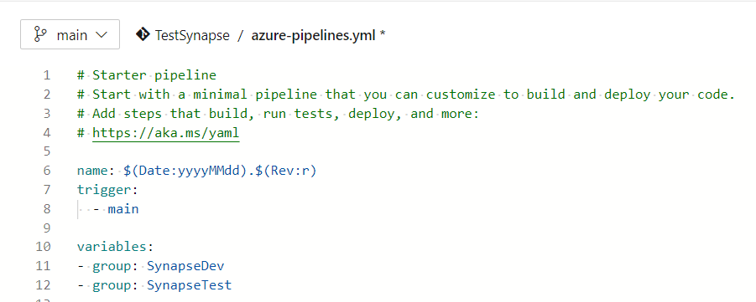
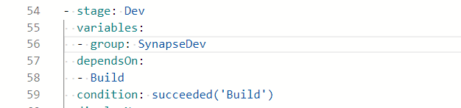
Azure Pipelines
Azure Pipelines –Variables Groups (linking to pipeline MSP)
Multistage YAML Pipelines
Link Variables on the top of the pipeline
…
Link variable group with the stage
Notes:
Reference need to happen in two places When Variables are define on the multistage pipelines
When Stage is invoked

Slide 65
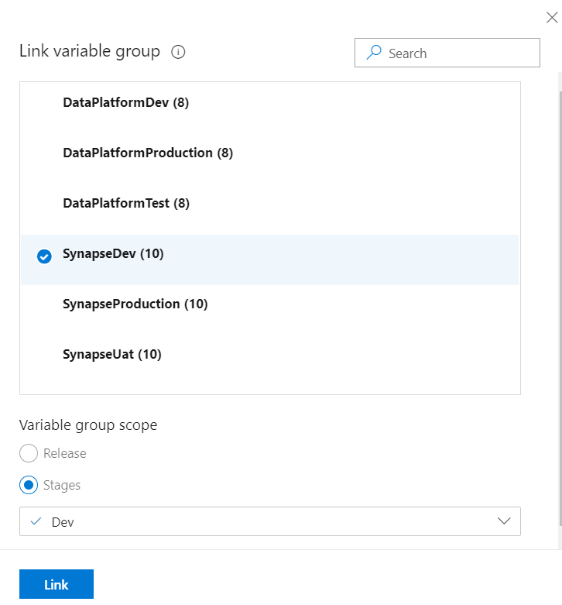
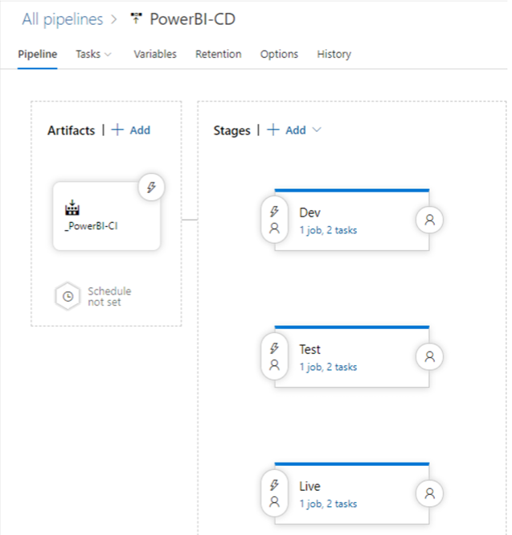
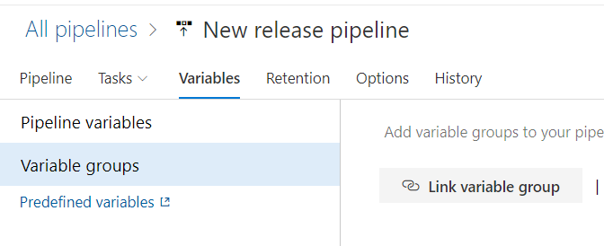
Azure Pipelines
Azure Pipelines –Variables Groups (linking to pipeline CP)
Classic Pipelines
Notes:
Variable Groups – it’s a set of Variables grouped together (same as variables but the are defined outside of the pipeline and then linked to the pipeline)
Use Variable groups per environment
There could be one to many relationship (many of variable groups can be linked with the same pipeline)
Variable are saved in the JSON (after importing pipeline Variable connections are broken) and need to be fixed as Pipelines does not use name but id for linkage

Slide 66
Agenda
Overview
Boards
Repos
Pipelines

Slide 67
Questions?

